Slide 1
• PROGRAM OF “PHYSICS”
Lecturer: Dr. DO Xuan Hoi
Room 413
E-mail : dxhoi@hcmiu.edu.vn

Slide 2
PHYSICS 4
(Wave and Modern Physics)
02 credits (30 periods)
Chapter 1 Mechanical Wave
Chapter 2 Properties of Light
Chapter 3 Introduction to Quantum Physics
Chapter 4 Atomic Physics
Chapter 5 Relativity and Nuclear Physics

Slide 3
References :
Halliday D., Resnick R. and Walker, J. (2005), Fundamentals of Physics, Extended seventh edition. John Willey and Sons, Inc.
Alonso M. and Finn E.J. (1992). Physics, Addison-Wesley Publishing Company
Hecht, E. (2000). Physics. Calculus, Second Edition. Brooks/Cole.
Faughn/Serway (2006), Serway’s College Physics, Brooks/Cole.
Roger Muncaster (1994), A-Level Physics, Stanley Thornes.

Slide 4
http://ocw.mit.edu/OcwWeb/Physics/index.htm
http://www.opensourcephysics.org/index.html
http://hyperphysics.phy-astr.gsu.edu/hbase/HFrame.html
http://www.practicalphysics.org/go/Default.html
http://www.msm.cam.ac.uk/
http://www.iop.org/index.html
.
.
.

Slide 5
PHYSICS 4
Chapter 5
Relativity and Nuclear Physics
SPECIAL THEORY OF RELATIVITY
Einstein's Postulates
Relativity of Time Intervals and of Length
Relativistic Dynamics
General theory of relativity
NUCLEAR PHYSICS
Properties of Nuclei
Nuclear Binding and Nuclear Structure
Nuclear Reactions
Radioactivity
Fundamental Particles - Quarks

Slide 6
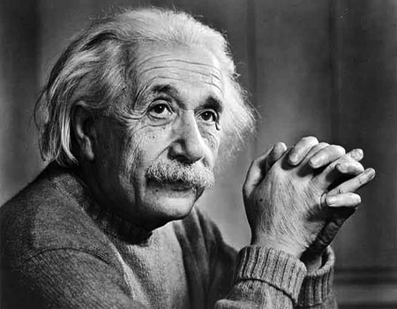
A. SPECIAL THEORY OF RELATIVITY
1 Einstein's Postulates
1.1 Einstein's First Postulate (the principle of relativity)
“The laws of physics are the same in every inertial frame of reference”
(inertial frame of reference : no acceleration)

Slide 7
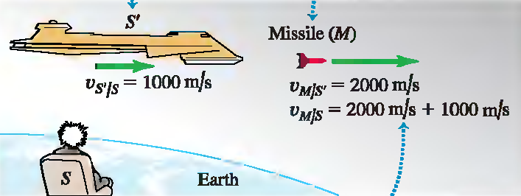
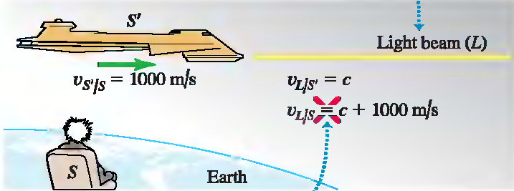
1.2 Einstein's Second Postulate
“The speed of light in vacuum is the same in all inertial frames of reference and is independent of the motion of the source. ”

Slide 8
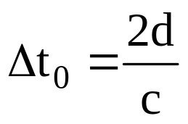
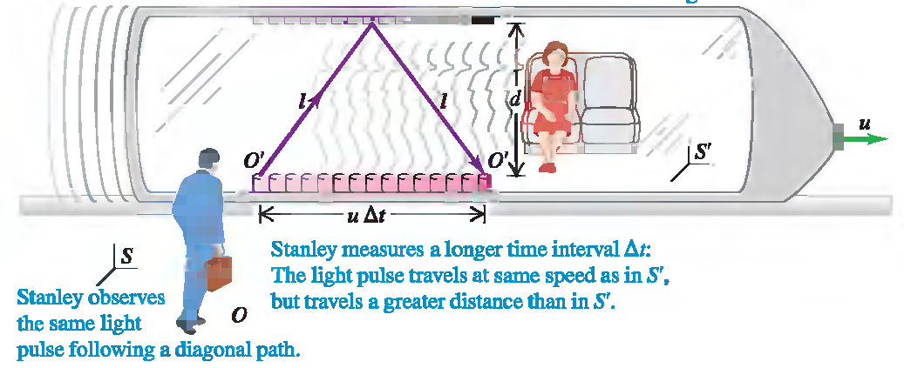
2 Relativity of Time Intervals
A frame of reference S' moves along the common x-x' -axis with constant speed u relative to a frame S
For S’ : Event 1 is when a flash of light from a light source leaves 0'. Event 2 is when the flash returns to 0'
For S’ : The time interval :

Slide 9
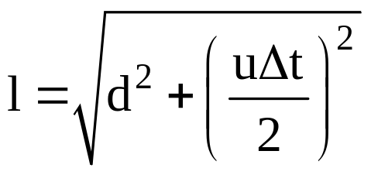
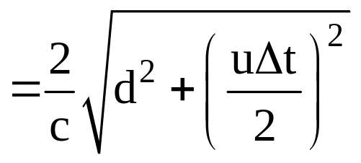
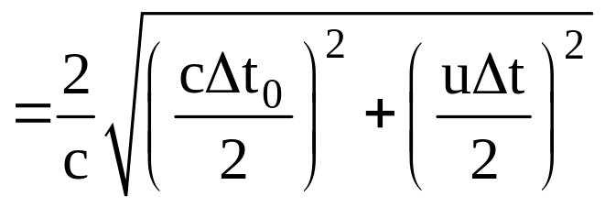
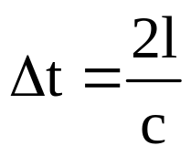
For S’ : The time interval :
For S : the round-trip distance is the longer distance 2l
For S : The time interval

Slide 10


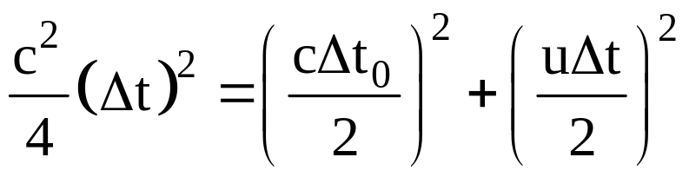
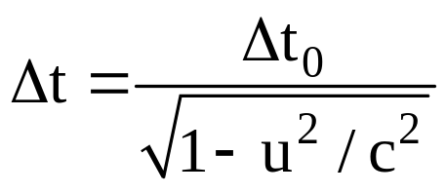
For S’ : The time interval :
For S : The time interval :

Slide 11
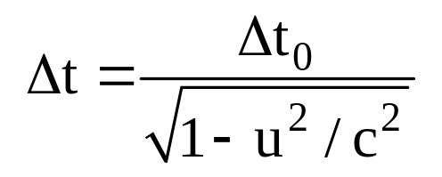
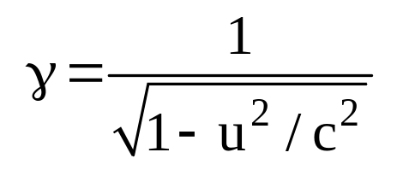

For S’ : The time interval :
For S : The time interval :
In a particular frame of reference, suppose that two events occur
at the same point in space. The time interval between these events,
as measured by an observer at rest in this same frame is Δt₀ .
Then an observer in a second frame moving with constant speed u
relative to the rest frame will measure the time interval to be Δt ,
where
Δt > Δt₀ : time dilation
Observers measure any clock to run slow if it moves relative to them

Slide 12
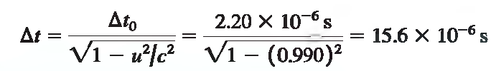
PROBLEM 1
A muon decays with a mean lifetime of 2.20×10⁻⁶ s as measured in
a frame of reference in which it is at rest. If a muon is moving at
0.990c (about 2.97×10⁸ m/s) relative to the earth, what will you
(an observer on earth) measure its mean lifetime to be?
SOLUTION
The mean lifetime of the muon in the earth frame (Δt) is about
seven times longer than in the muon's frame (Δt₀).

Slide 13


PROBLEM 2
An airplane flies from San Francisco to New York (about 4800 km)
at a steady speed of 300 m/s.
How much time does the trip take, as measured by an observer on
the ground ? By an observer in the plane ?
SOLUTION
The time interval measured by ground observers :
The time interval in the airplane (proper time) :

Slide 14
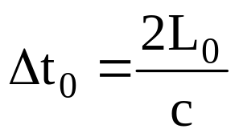
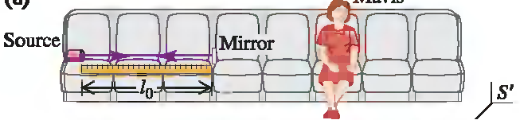
3 Relativity of Length
A frame of reference S' moves along the common x-x' -axis with constant speed u relative to a frame S
For S’ : A light source to one end of a ruler and a mirror to the other end. The ruler is at rest in reference frame S', and its length in this frame is L₀ . Then the time required for a light pulse to make the round trip from source to mirror and back is

Slide 15


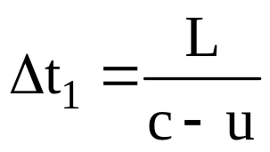

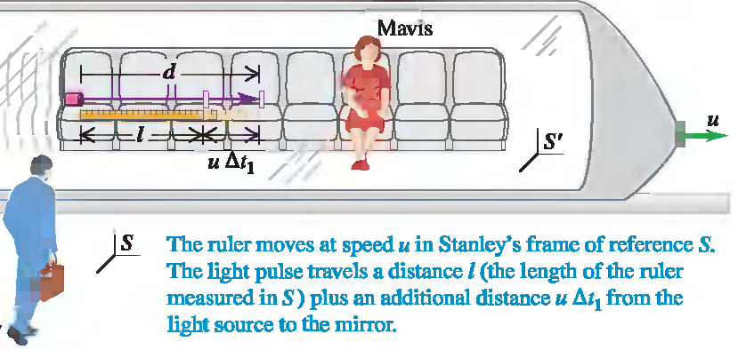
For S : the ruler is moving to the right with speed u during this travel of the light pulse
The length of the ruler in S is L, and the time of travel from source
to mirror, as measured in S, is Δt₁.
The total length of path d from source to mirror is
The light pulse travels with speed c, so :

Slide 16
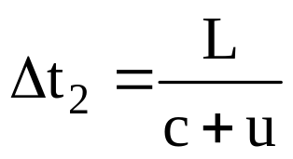
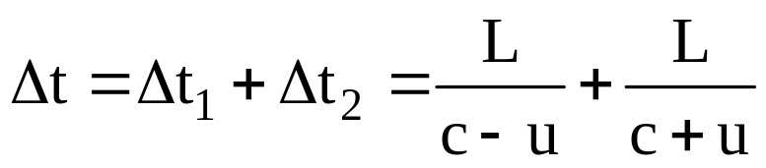
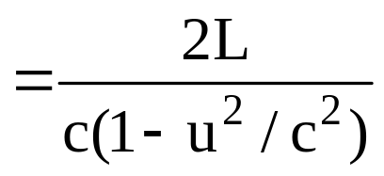
The length of the ruler in S is l, and the time of travel from source
to mirror, as measured in S, is Δt₁ :
In the same way we can show that the time Δt₂ for the return trip
from mirror to source :
The total time for the round trip, as measured in S :_x001f__x001d_

Slide 17
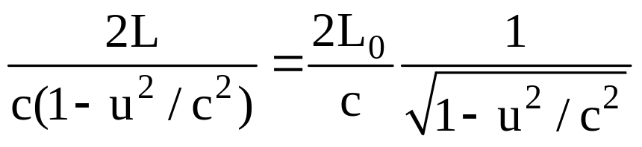
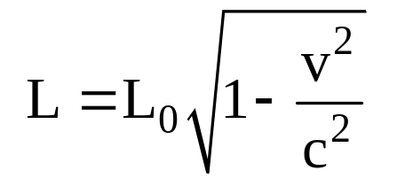
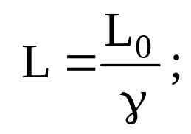
Because :
( L < L₀ )
(Length contraction)
The length L measured in S, in which the ruler is moving,
is shorter than the length L₀ measured in its rest frame S'.
(A length measured in the frame in which the body is at rest
is called a proper length; thus L₀ is a proper length in S')

Slide 18
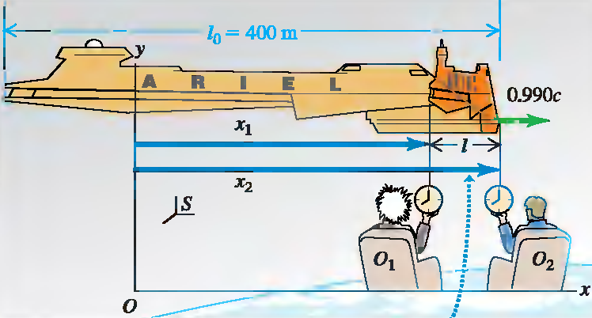



PROBLEM 2
A spaceship flies past earth at a speed of 0.990c. A crew member on board the spaceship measures its length, obtaining the value
400 m. What length do observers measure on earth?
SOLUTION

Slide 19
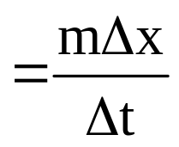

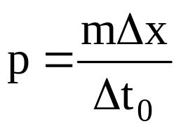
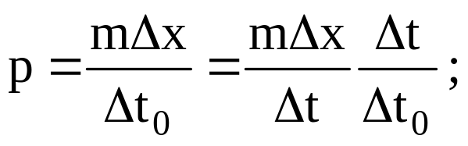
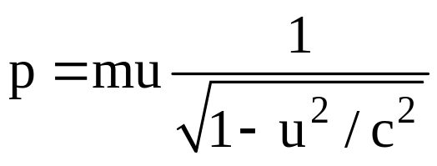
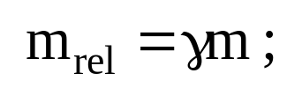
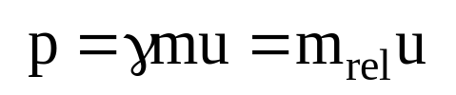
4. Relativistic Dynamics
4.1 Relativistic Momentum and Relativistic Mass
Classical momentum :
Relativistic Momentum :
(Δt₀ : time required to travel the distance Δx measured
by an observer moving with the particle )
With m : rest mass
Relativistic mass m_{rel} :
Relativistic Momentum :

Slide 20
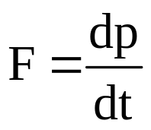
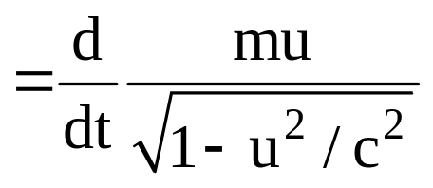
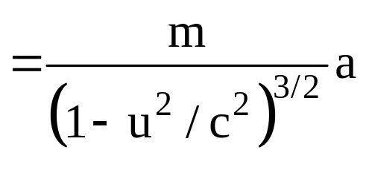
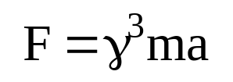
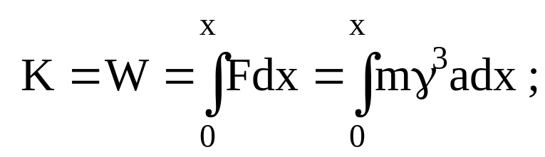
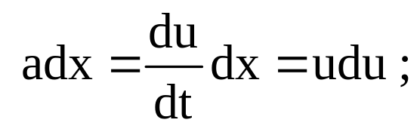
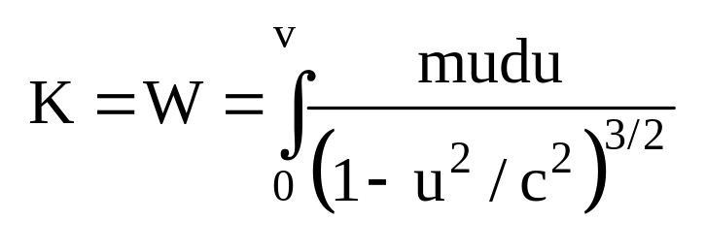
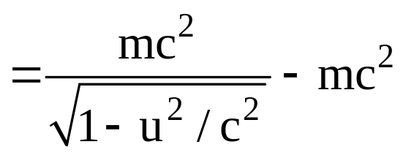
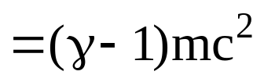
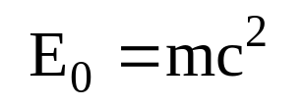
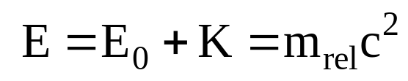
4.2 Relativistic Energy
• The relativistic generalization of Newton's second law
• Relativistic Kinetic Energy
Rest energy :
Total energy :

Slide 21
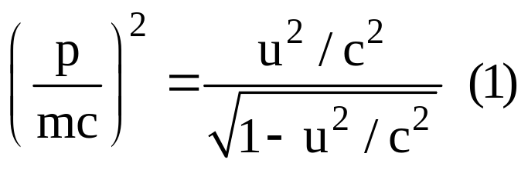
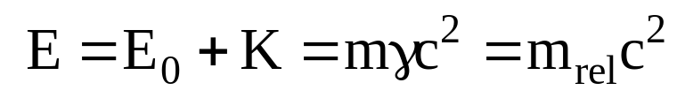
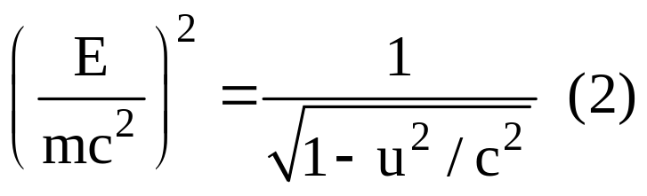
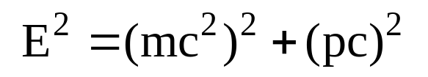
• Total Energy and Relativistic Momentum
(1) and (2) →

Slide 22
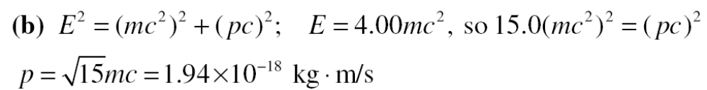
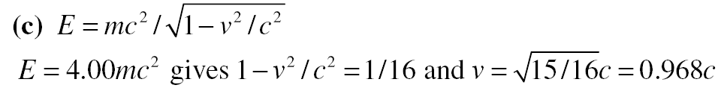
PROBLEM 3
A proton (rest mass 1.67 ×10⁻²⁷ kg) has total energy that is 4.00
times its rest energy. What are (a) the kinetic energy of the proton ; (b) the magnitude of the momentum of the proton ; (c) the speed of
the proton?
SOLUTION

Slide 23
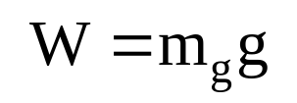
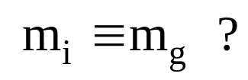

5. General theory of relativity
Gravitational property:
Inertial property:
Postulates of Einstein’s general theory of relativity:
• All the laws of nature have the same form for observers in any frame of reference, whether accelerated or not.
• Principle of equivalence: In the vicinity of any point, a gravitational field is equivalent to an accelerated frame of reference in the absence of gravitational effects.

Slide 24



The curvature of space–time: the presence of a mass causes a curvature of space–time in the vicinity of the mass, and this curvature dictates the space–time path that all freely moving objects must follow
If the concentration of mass becomes very great (when a large star exhausts its nuclear fuel and collapses to a very small volume):
a black hole.
The curvature of space–time is so extreme that, within a certain distance from the center of the black hole, all matter and light become trapped.

Slide 25




B. NUCLEAR PHYSICS
1 Properties of Nuclei
• Every atom contains at its center an extremely dense, positively charged nucleus, which is much smaller than the overall size of the atom but contains most of its total mass.
• Model : a nucleus is a sphere with a radius R that depends on the total number of nucleons (neutrons and protons):
Nucleon number A (mass number).
• The proton mass and the neutron mass are both approximately 1u = 1.66053886 × 10⁻²⁷ kg = 931.5 MeV/c²
• The number of protons in a nucleus is the atomic number Z. The number of neutrons is the neutron number N.
• The radii of most nuclei :

Slide 26
• A single nuclear species having specific values of both Z and N is called a nuclide.
• Some nuclides that have the same Z but different N: isotopes of that element
EXAMPLE :
• Chlorine (Cl, Z = 17). About 76% of chlorine nuclei have
N = 18; the other 24% have N = 20.
• Two common isotopes of uranium with A = 235 and 238

Slide 27





Slide 28


2 Nuclear Binding and Nuclear Structure
• The binding energy E_{B} : the magnitude of the energy by which the nucleons are bound together.
• Total rest energy E₀ of the separated nucleons is greater
than the rest energy of the nucleus.
• The rest energy of the nucleus :
• The binding energy for a nucleus containing Z protons and N neutrons :

Slide 29


Slide 30

PROBLEM 4
Because it has the highest binding energy per nucleon of all
nuclides, Ni (Z=28;A=62) may be described as the most strongly bound. Its neutral atomic mass is 61.928349 u. Find its mass defect. its total binding energy, and its binding energy per nucleon.
SOLUTION

Slide 31



3 Nuclear Reactions
• Nuclear reactions : Rearrangements of nuclear components that result from a bombardment by a particle
• Several conservation laws : The classical conservation principles for charge, momentum, angular momentum, and energy (including rest energies)
EXAMPLE :
Conservation of charge : 2 + 7 = 8 + 1
Conservation of nucleon number A : 4 +14 = 17 + 1
• Reaction energy :
Δm : mass defect

Slide 32




PROBLEM 5
When lithium is bombarded by a proton, two alpha particles
( ) are produced. Find the reaction energy.
SOLUTION

Slide 33


3.1 Fission Reactions
• Nuclear fission is a decay process in which an unstable
nucleus splits into two fragments of comparable mass.
EXAMPLE :
• Chain Reactions : Fission of a
uranium nucleus, triggered by
neutron bombardment, releases
other neutrons that can trigger
more fissions

Slide 34




PROBLEM 6
Calculate the energy released in the fission reaction
You can ignore the initial kinetic energy of the absorbed neutron.
The atomic masses are , 235.043923 u; , 139.921636 u;
and , 93.915360 u.
SOLUTION

Slide 35


3.2 Nuclear Fusion
• In a nuclear fusion reaction, two or more small light nuclei
come together, or fuse. to form a larger nucleus.
• Fusion reactions release energy for the same reason as
fission reactions: The binding energy per nucleon after the
reaction is greater than before.
EXAMPLE :
• Atoms have this much energy only at extremely high temperatures : thermonuclear reactions.

Slide 36



PROBLEM 7
Two deuterons fuse to form a triton (a nucleus of tritium, or )
and a proton. How much energy is liberated?
SOLUTION

Slide 37







4. Radioactivity
• Among about 2500 known nuclides, fewer than 300 are stable. The others are unstable structures that decay to form other nuclides by emitting particles and electromagnetic radiation, a process called radioactivity.
• The time scale of these decay processes ranges from a small fraction of a microsecond to billions of years.
• When unstable nuclides decay into different nuclides,
they usually emit alpha (α) or beta (β) particles:
Alpha particle is a ⁴He nucleus, a beta-minus particle (β⁻) is an electron, beta-plus particle (β⁺) is a positron (antiparticle of electron)

Slide 38






EXAMPLE :
What nuclide is produced in the following radioactive
decays?
(a) α decay of
(b) β⁻ decay of
(c) β⁺ decay of
SOLUTION

Slide 39



• Radioactive Decay Rates
• N(t) : the (very large) number of radioactive nuclei in a sample at time t,
dN(t) : the (negative) change in that number during a short time interval dt
- dN(t)/dt is called the decay rate or the activity of the specimen.
Activity: becquerel (Bq) in SI or curie (Ci)
λ : decay constant
• The half-life T_{1/2} is the time required for the number of radioactive nuclei to decrease to one-half the original number N₀

Slide 40

• The mean lifetime T_{mean} (generally called the lifetime):

Slide 41


PROBLEM 8
The radioactive isotope ⁵⁷Co decays by electron capture with a
half-life of 272 days. (a) Find the decay constant and the lifetime.
(b) If you have a radiation source containing ⁵⁷Co, with activity
2.00 μCi, how many radioactive nuclei does it contain? (c) What
will be the activity of your source after one year?
SOLUTION

Slide 42



PROBLEM 8
The radioactive isotope ⁵⁷Co decays by electron capture with a
half-life of 272 days. (a) Find the decay constant and the lifetime.
(b) If you have a radiation source containing ⁵⁷Co, with activity
2.00 μCi, how many radioactive nuclei does it contain? (c) What
will be the activity of your source after one year?
SOLUTION

Slide 43



PROBLEM 9
The isotope ²²⁶Ra undergoes a decay with a half-life of
1620 years.
What is the activity of 1.00 g of ²²⁶Ra?
Express your answer in Bq and in Ci.
SOLUTION

Slide 44

5. Fundamental Particles. Quarks
More than 30 long-lived particles and antiparticles have been detected experimentally.
(An antiparticle has the same mass and spin as its associated particle, but the electromagnetic properties, such as charge and magnetic moment, are opposite in a particle and its antiparticle.
EX: electron and positron)
Hundreds of resonances particles have been observed.
In contrast with the relatively stable particles, a resonance particle is extremely short-lived (< 10⁻²¹ s).

Slide 45

truly elementary
particle (not composed of smaller entities)
composed of more basic particles (quarks)

Slide 46

QUARKS MODEL (M. Gell-Mann and G. Zweig, 1963)
Hadrons are built from six quarks (u, d, s, c, b, t)
and their six antiquarks (u, d, s, c, b, t).
u : up,
d : down
s : strange
c : charm
b : bottom
t : top
proton quark content : (uud)
antiproton quark content :
(u, u, d)
neutron quark content : (udd)
antineutron quark content :
(u, d, d)

Slide 47

The Fundamental Interactions

Slide 48
The Standard Model
Three families of particles:
(1) the six leptons, which have no strong interactions;
(2) the six quarks, from which all hadrons are made;
(3) the particles that mediate the various interactions. These mediators are :
Gluons for the strong interaction among quarks, Photons for the electromagnetic interaction,
W± and Z⁰ particles for the weak interaction
Graviton for the gravitational interaction.

